Slide 1


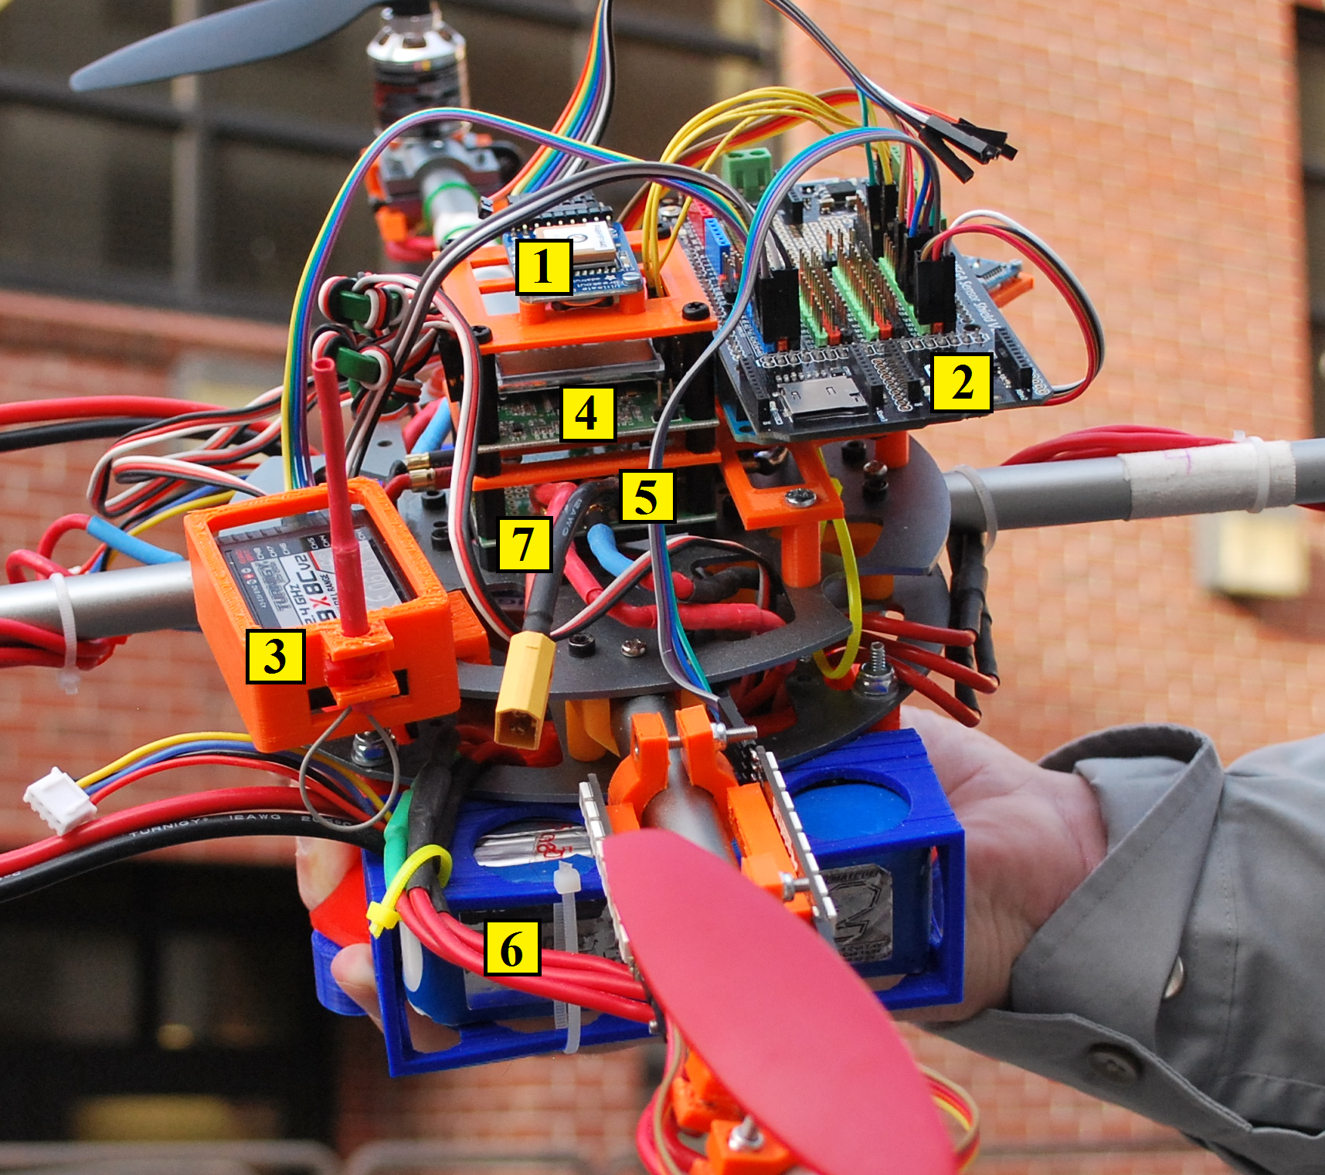
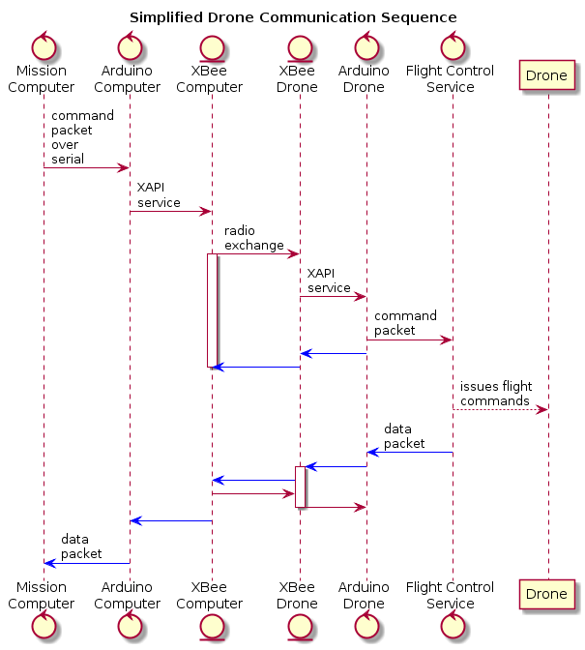
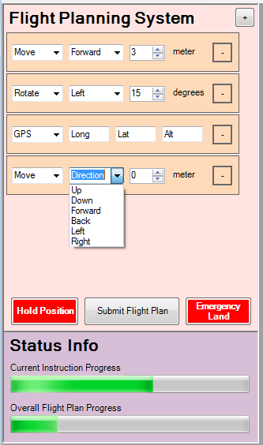
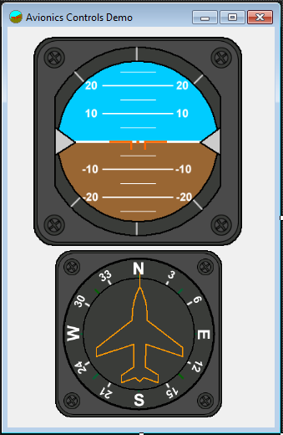

MISSION CONTROL
The Mission
The Drone
To design and construct a stable and flying quadcopter and, a remote communications systems to send flight plans to the drone and receive in-flight drone vitals. In addition, a flight planning and monitoring software that is capable of developing 3D flight plans and summarize status of the drone during flight.
Global Positioning System
Currently not implemented
Arduino Mega 2560
Controls auto pilot subroutines
Tells the flight computer where to steer the drone
Handles internal & external communications
Receiver
remote control receiver for handheld manual controller
Flight Computer
Handles self leveling
10 Degrees of Freedom
3 axis instrumentation sensor
Batteries
Power Distribution Hub
Located central to all systems that require power
Project Learning
Drone Hardware
Some initial issues were drifting during flight due to misaligned center of gravity. A part holder was designed to center the distribution of weight. The part holder was printed at a lower density plastic to minimize the added weight it would contribute.
Communications
Our system requires two-way communication between computer and the Arduino located on the drone. This system takes an instruction created on the computer, sent over serial to the connected Arduino, pass it to XAPI, XAPI then ships it over XBee to the Arduino on the drone. A flight control service then executes the instruction.
Mission Planner & Flight Monitoring
The planning/monitoring software was developed using C#. C# is widely used and a lot of open source programs were referenced in the making of this software. The planner allows for the development and transfer of 3D mission plans. When the drone is in flight its coordinates and flight details are updated in an instrument panel and coordinate system.
Making a Flight Plan
Sending a Flight Plan
Monitoring Flight
The Flight Planning System allows the user to make 3D flight plans. Each flight plan is built from individual instructions. There are three instructions types: Move, Rotate, and GPS.
Move – allows for
vertical or horizontal
movement in meters
Rotate – turns the
drone left or right by
a specified number of degrees
GPS – give the drone
specific coordinates
to move to
Click “Submit Flight Plan” to send instructions in the order they were added.
During flight the drone reports on data relevant to its position, attitude, and heading. This data is presented to the viewer using the instrument panel and coordinate mapping system. This data is also used to measure the success of a flight plan.
The Team
Members
David Klingenberg – CS
Taylor Trabun – CS
Emeth Thompson – CS
Joe Higley – CS
Client
Brandon Ortiz
Advisors
Bruce Bolden
Robert Rinker
Once the user clicks “Submit”, the flight plan goes thru a number of steps before it is received by the drone.
A packet or series of packets are formatted
Packets are sent via serial to the connected Arduino
The Arduino uses XAPI to interface with XBee wireless communications module
XBee then synchronizes the transfer with the XBee on the drone.

